Slide 1

Group 8: Student Final Grade
Mengyang Yi
Xiaozhe Shao
Weiming Hao
Yaxuan Shi
Notes:
Hello everyone, Today I am going to introduce the project conducted by our group…

Slide 2
Data
The data seems to be a mix of categorical (e.g., sex, address, Mjob, Fjob, reason, guardian) and numerical variables (e.g., age, Medu, Fedu, traveltime, studytime, G1, G2, G3). Some variables are binary (e.g., paid, activities, nursery, higher), represented with "yes" or "no".
We choose G3 as target variable for predicting student performance, given that they represent grades over three periods. This dataset could be used for various analyses, such as understanding the impact of family background on academic performance or predicting student grades based on demographic and social factors.
Notes:
As we all know, The first thing is often to collect and analyze the data we got. In this project our goal is to predict the grade from the third exam. There are a lot of variables that we have in our datasets. The categorical variable, for example….Also, we have the Numerical variables like … Some datas are hard to analyze so we need to do some transformation and make them into numerical variables.

Slide 3
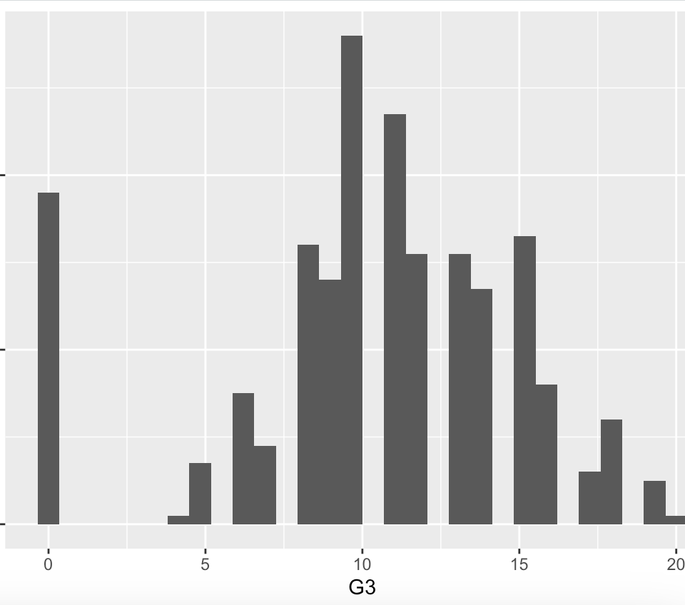
Outliers & Missing data
From the distribution of G3, we can tell that 0 might be the outlier. So, we use the IQR to check.
Lower bond= -1
Upper bond=23
0 is between the lower bond and the upper bond. So, 0 is not the outlier.
Notes:
When we analyze the data of G3, we might find out that 0 is the outlier trough this histogram...But after the boxplot and the use of IQR, we may find out that 0 lies between the lower bond and upper bond. So, 0 is not the outlier…

Slide 4
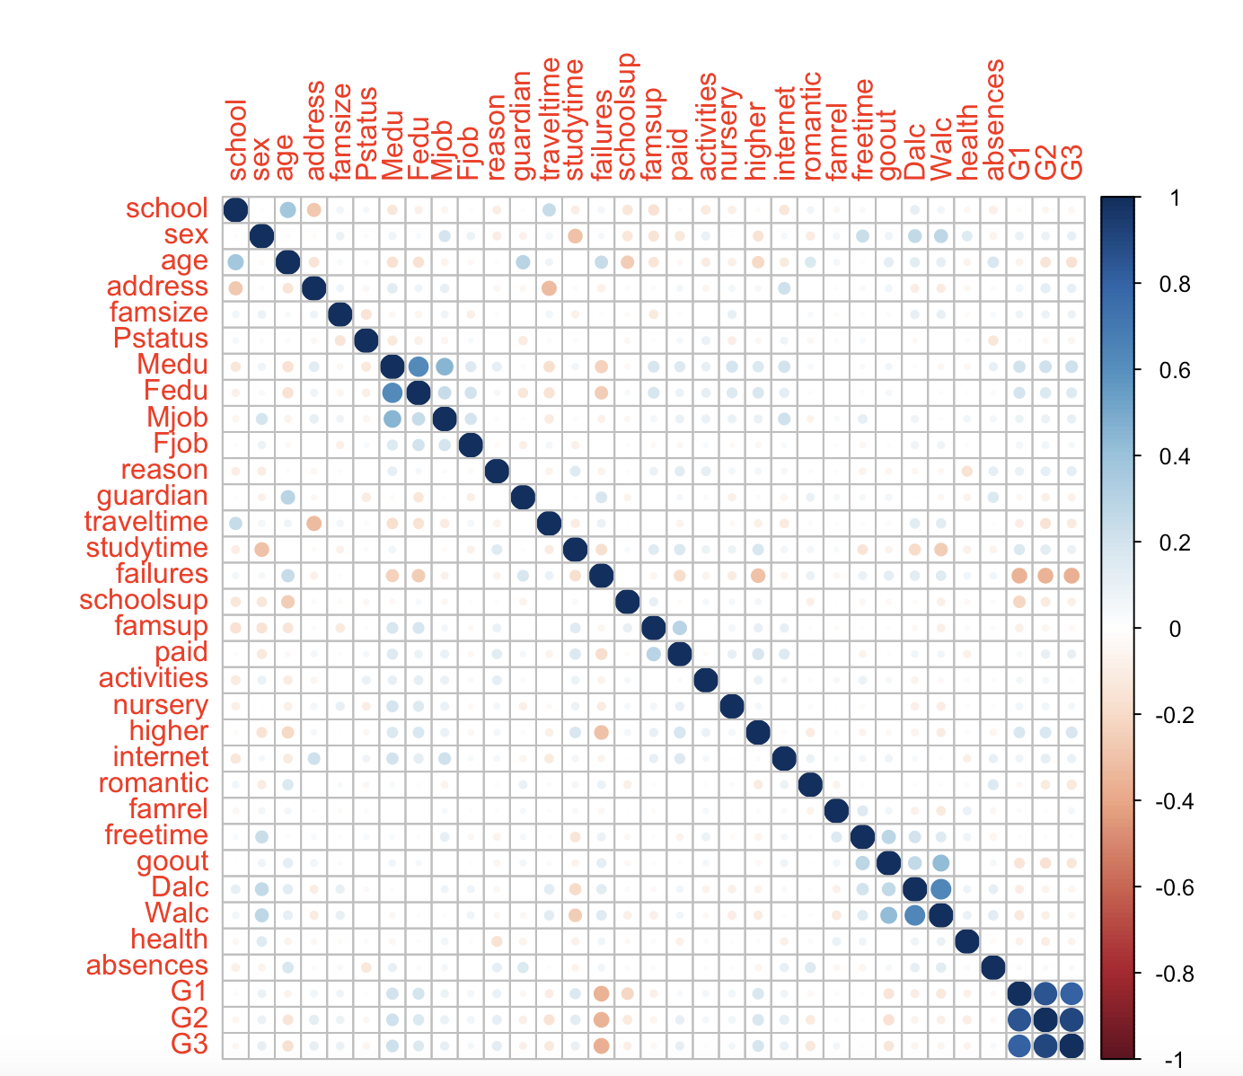
Correlation
Notes:
This is correlation matrix conducted by R corrplot.
From this chart we can see that the dark blue and dark red represents the data that are most correlated.
From here (图），we can see that
Positively strong correlated: G3 vs G1, G2
Negatively strong correlated: G3 vs failure.
Moderately correlated: G3 vs study time, mother education, father education (Medu, Fedu)

Slide 5
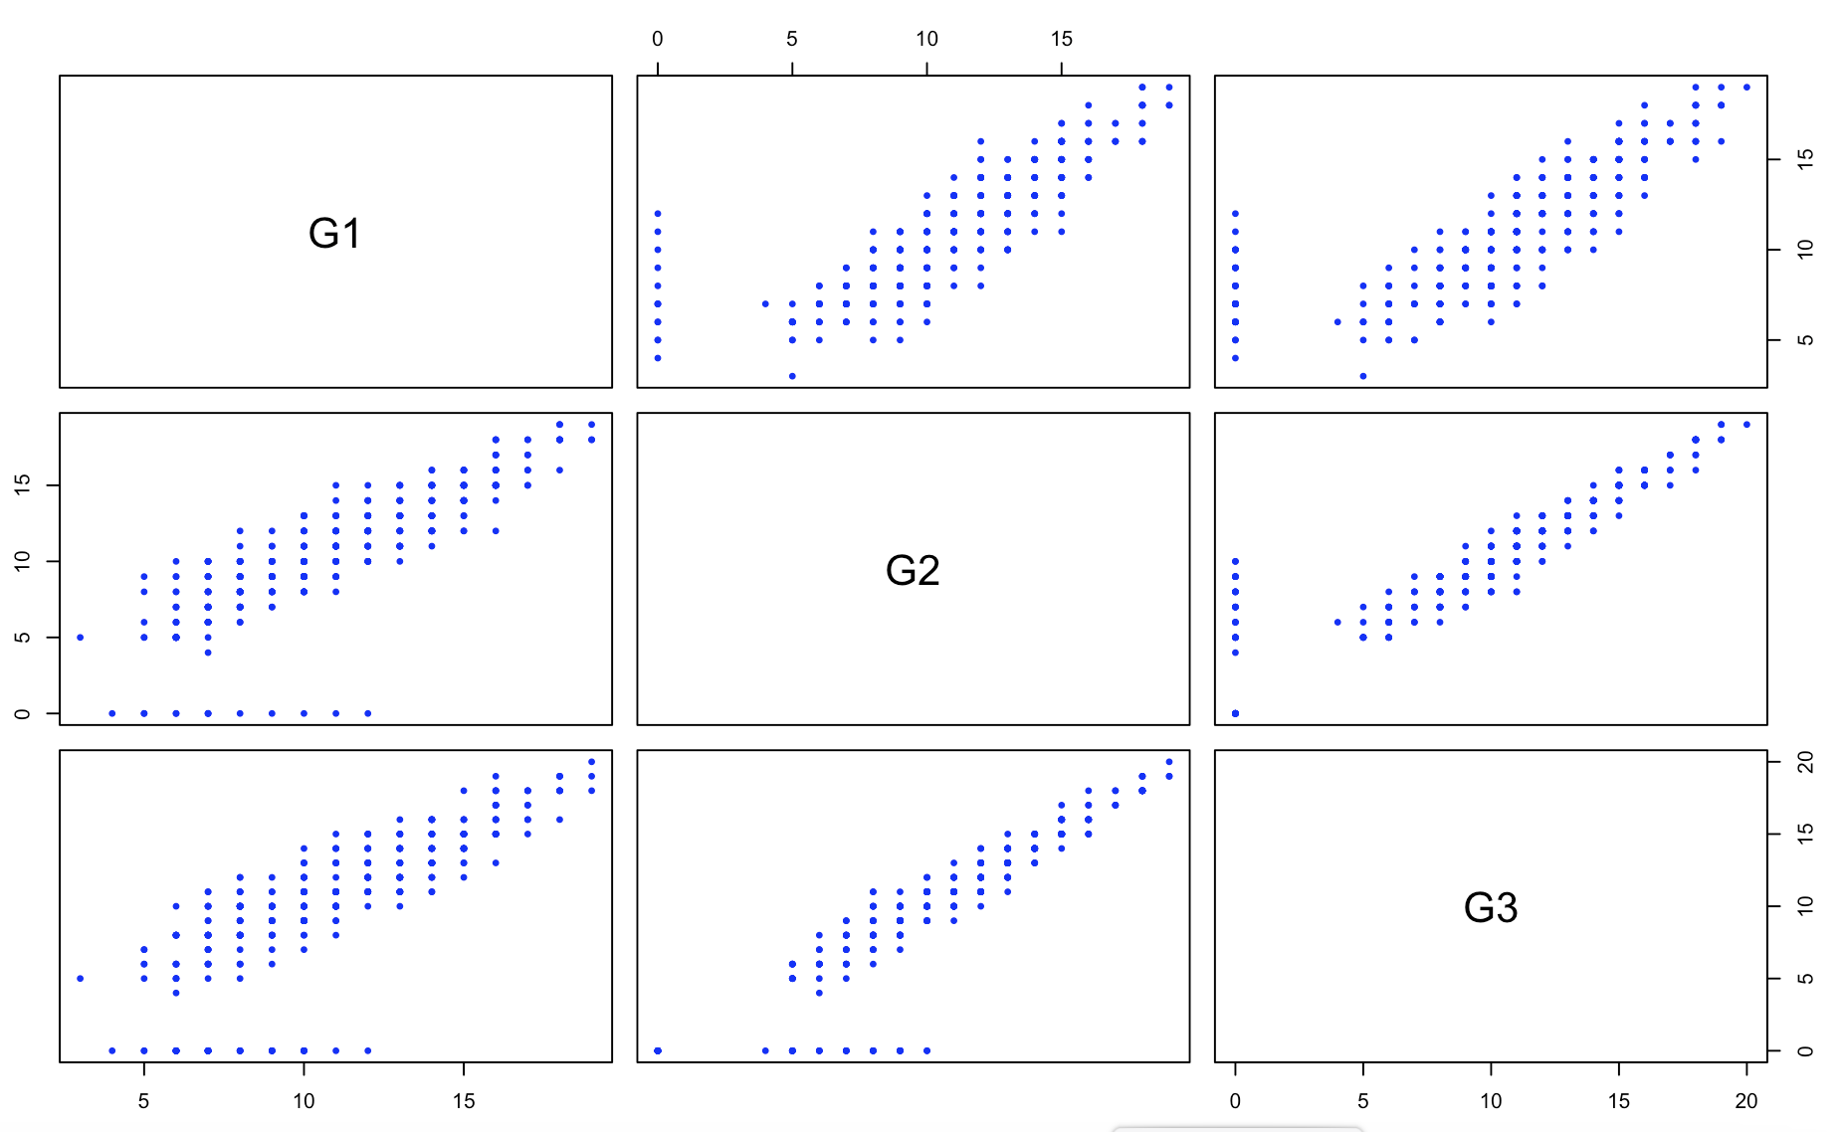
G1,G2,G3 correlation
Notes:
Here is another draft for detect the relationship between the G1, G2, and G3. G1 G2 vs G3 are positively correlated. The common sense also explain the relationship of these three variables. Usually, students who do well in the first two exams, have the high likelihood doing well in the third exam.

Slide 6

KNN
K-Nearest Neighbors (KNN): A machine learning algorithm that makes predictions for a new data point by considering the majority class or average value of its K-nearest neighbors in the training dataset, where proximity is typically measured using a distance metric such as Euclidean distance.
Notes:
KNN is the first method we choose to analyze the bunch of these datas. (念定义）

Slide 7
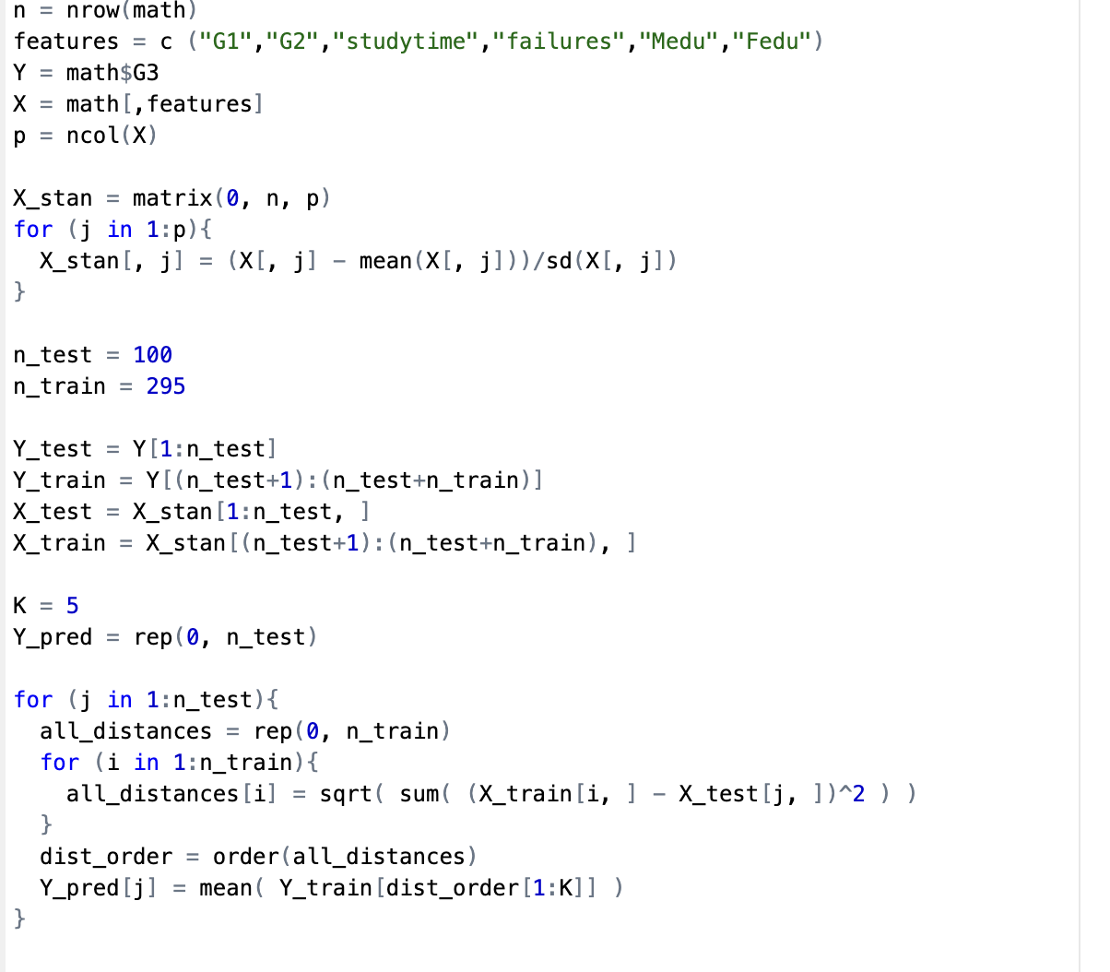
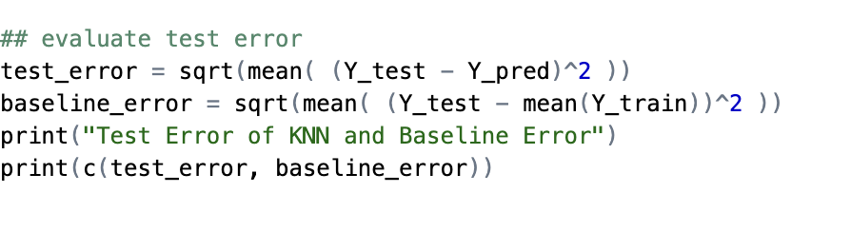
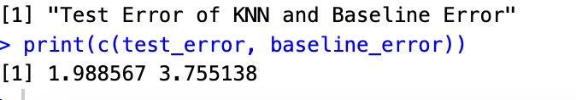
KNN (code)
Notes:
There are totally 395 datasets in the file. We randomly choose 200 datasets as the training data, and the rest of it as the test data. For this code, we set k=5. after running this code we get the result that test error is 1.989 and the baseline error is 3.755.

Slide 8
Comparison
K | Test error
3 | 2.397
5 | 1.989
10 | 1.693
K= 10 is the best because it has the minimum test error
Notes:
K usually influences the test error. Here we choose 3, 5 10 for comparison. From this chart we can tell that ...

Slide 9

Conclusion
The test error of the KNN model is approximately 1.693, while the baseline error is approximately 3.7551.
The choice of the value of 'K' (number of nearest neighbors) is crucial for KNN. In this code, ‘K’ is set to 10.
Notes:
So, we should choose k equals 10, again the test error is 1.693 and the baseline error is 3.755. Since the test error is smaller than the baseline error. In other word, the KNN model performs better than the baseline model. This suggests that the KNN model has learned some meaningful relationships between the selected features and the target variable 'G3', allowing it to make more accurate predictions compared to a simple mean prediction.

Slide 10

KNN V.S Variable Selection
K-Nearest Neighbors (KNN):
KNN predicts outcomes based on how closely input data resembles the training data.
It uses all features for predictions, not selecting or reducing them.
It's computationally intensive, especially with many features, because it evaluates all features for each prediction.
Variable Selection:
The goal is to boost model accuracy and interpretability by choosing only the most important features.
It reduces overfitting and complexity, which can lead to more straightforward models and save computational resources.
Unlike KNN, it involves reducing the number of features before model training.
Notes:
The second method we consider is through the variable selection. Compared to the KNN, we can find out that variable selection only choose the most important features for analyze. It subtracts the irrelevant variables before the model training. In a certain degree, it reduces the overfitting and simplify the computation.

Slide 11
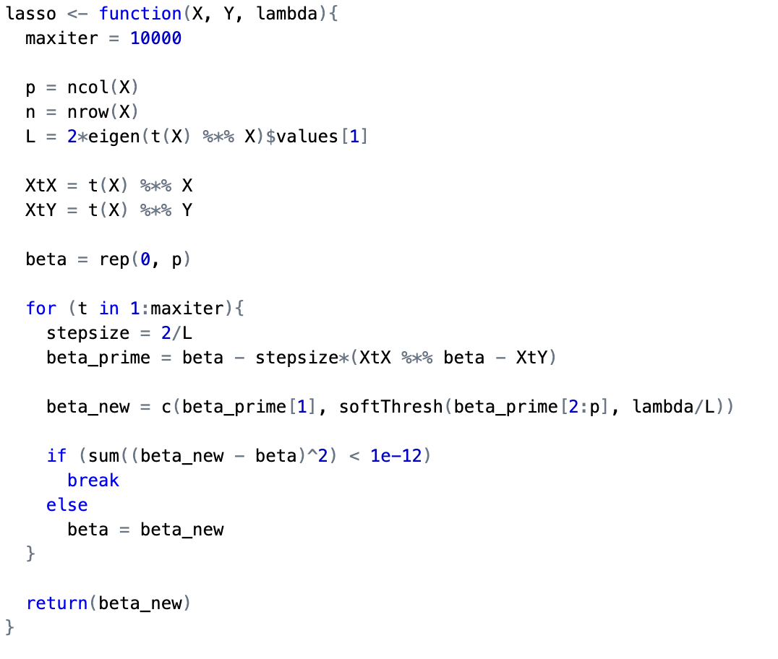
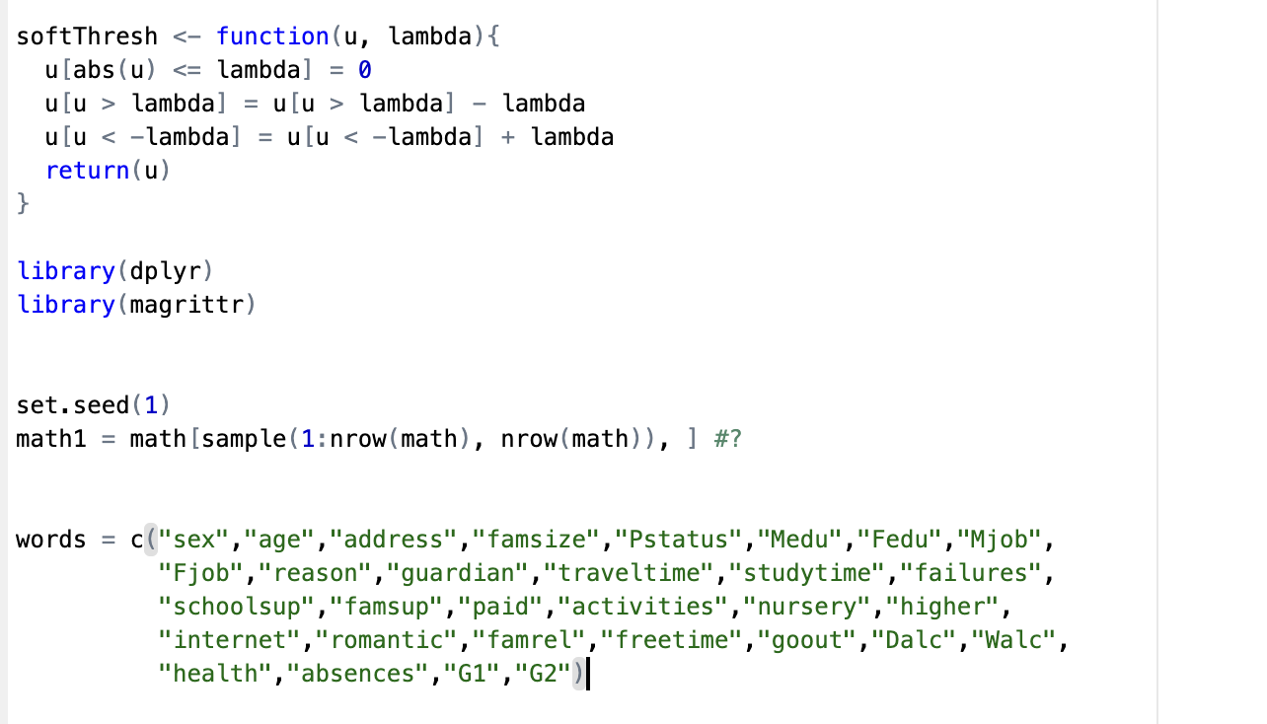
Lasso (code)
Notes:
Here is the code of the Lasso

Slide 12
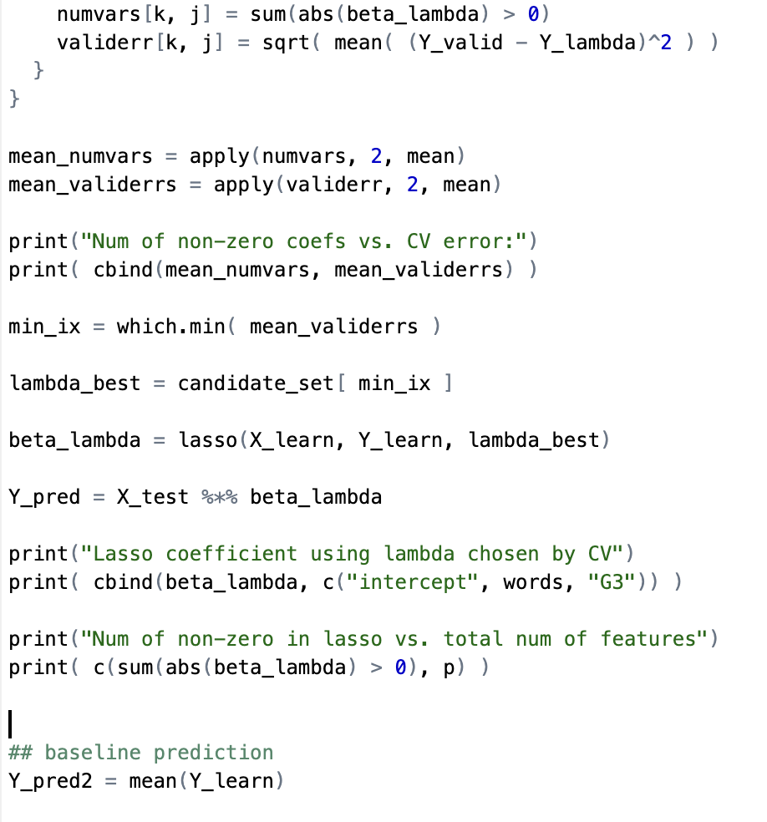
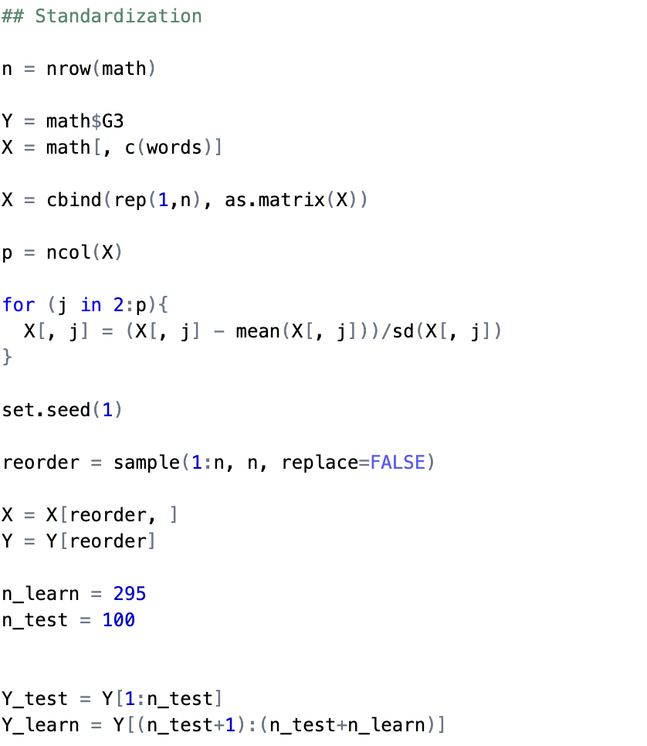
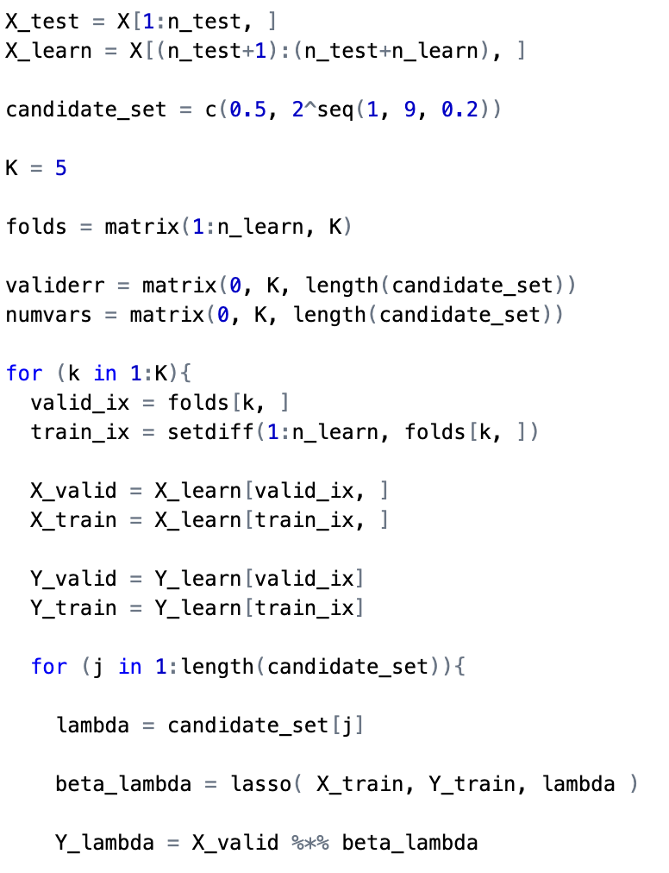
Lasso (code) –continued.
Notes:
And we choose k=5 as the folds.

Slide 13
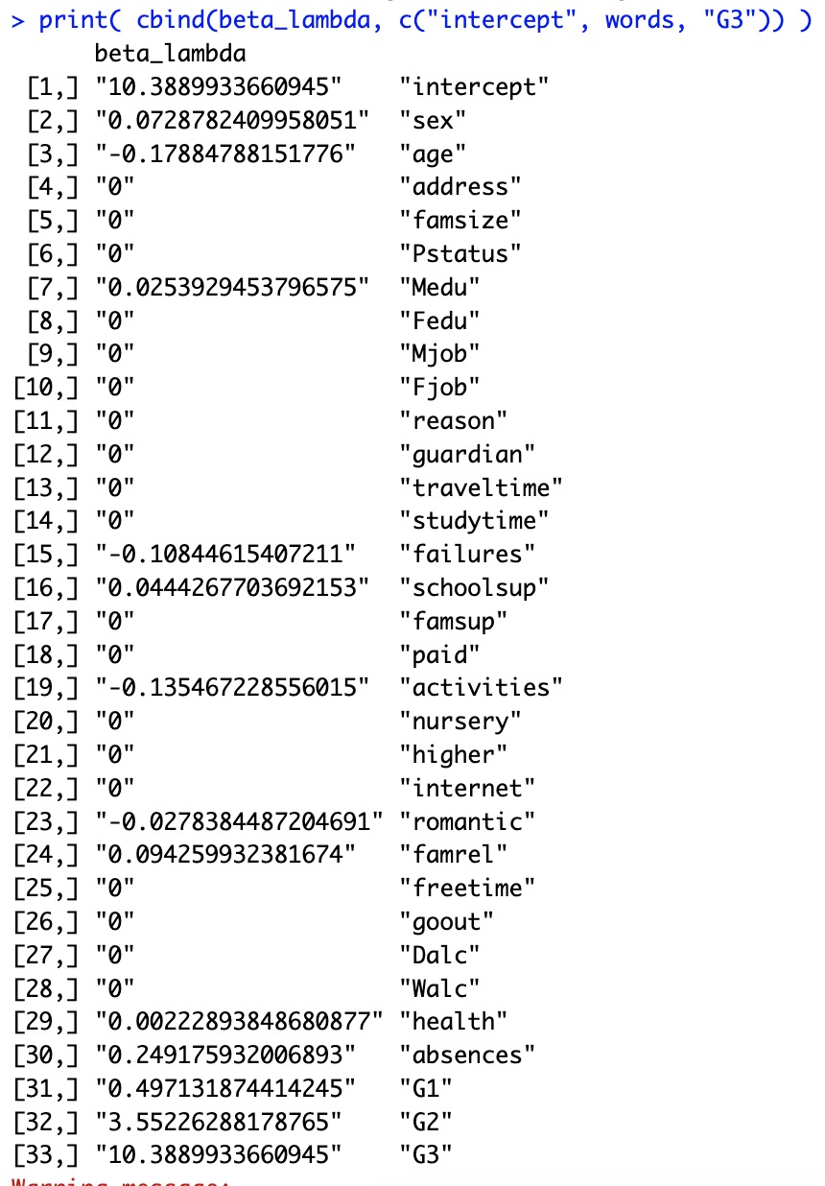
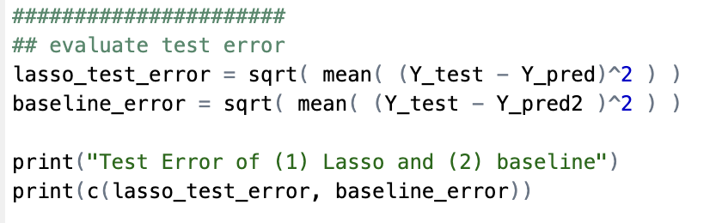
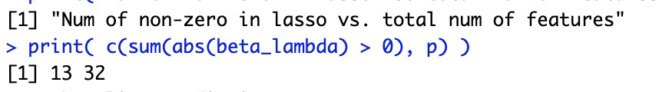
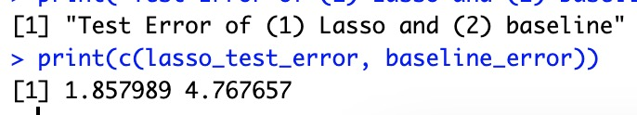
Lasso (code) –continued.
Notes:
After running the code we find that With this optimal lambda, the model calculates the coefficients for each feature. The coefficients show the impact of each variable on the response variable (G3).Here some coefficients equals 0, which shows that these features are not that much important. So, we should care the features whose coefficients are non-zero. Non-zero coefficients represent features that are important in predicting the final grade. The lasso model selected 13 features out of the total 32 for its non-zero coefficient. So only 13 features are important. The test error of the lasso is approximately 1.858.

Slide 14
Lasso V.S KNN
Comparing this to the test error for the lasso model (approximately 1.858 from your earlier message), we can conclude that the KNN model (1.693) performs slightly better than the lasso model with the selected features on this dataset.
Notes:
Lasso is with test error 1.858 and KNN with the test error 1.693 from the earlier message, so we can conclude that…KNN nb !!!

Slide 15
Future Recommendations
To enhance insights into student performance, a focused analysis should pinpoint influential features for educators and policymakers. Experimentation with various 'K' values in KNN and optimizing the regularization parameter in Lasso Regression can boost model performance. Expanding the dataset with additional relevant features, exploring temporal factors, and implementing thorough cross-validation are recommended strategies for a more comprehensive understanding and robust evaluation of the predictive models.
Notes:
As for the recommendation for the future….

